Slide 1
Special Sensory and Integumentory System
Krishna Bastola
B.Sc. MLT, M.Sc.

Slide 2
Introduction
The special senses of hearing, sight, smell and taste all have specialised sensory receptors (nerve endings) outside the brain.
These are found in the ears, eyes, nose and mouth.
The ear is also involved in the maintenance of balance.
In the brain the incoming nerve impulses undergo complex processes of integration and coordination that result in perception of sensory information and a variety of responses inside and outside the body.

Slide 3
Ear

Slide 4
Ear
The ear is the organ of hearing.
It is supplied by the 8th cranial nerve, i.e. the cochlear part of the vestibulocochlear nerve which is stimulated by vibrations caused by sound waves.
With the exception of the auricle (pinna), the structures that form the ear are encased within the petrous portion of the temporal bone.
Besides the function of hearing, the stimulation of vestibular labyrinth can cause vertigo, nausea, vomiting and nystagmus.
Structure
The ear is divided into three distinct parts:
• outer ear
• middle ear (tympanic cavity)
• inner ear.
Notes:
Nystagmus: Involuntary rhythmic oscillation of one or both eyes. There are several causes including nervous disorders, vestibular disorders, eye disorders and certain drugs including alcohol.

Slide 5
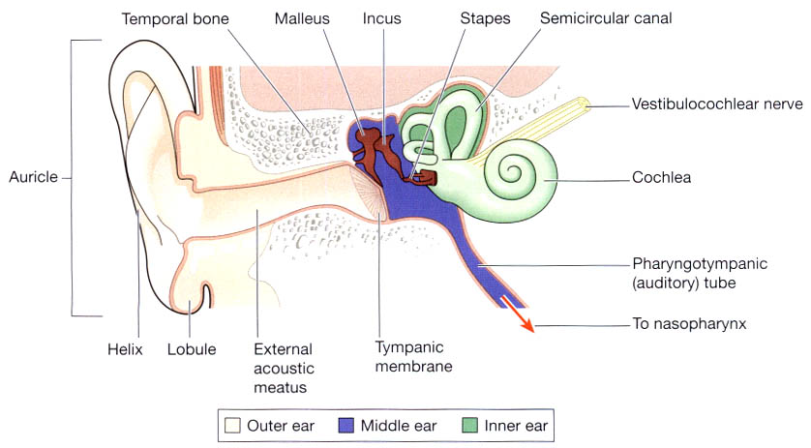
Ear
Ossicles
(Eustachian tube)
Fig: The parts of ear.

Slide 6
Inflammatory lesions and disorders of ear

Slide 7


Inflammatory lesions and disorders of ear
OTITIS MEDIA:
This is the term used for inflammatory involvement of the middle ear. It may be acute or chronic.
The usual source of infection is via the eustachian tube and the common causative organisms are Streptococcus pneumoniae, Haemophilus influenzae and β-Streptococcus haemolyticus.
Otitis media may be suppurative, serous or mucoid.
Acute suppurative otitis media (SOM) clinically presents as tense tympanic membrane along with pain and tenderness and sometimes mastoiditis as well.

Slide 8
Inflammatory lesions and disorders of ear
OTITIS MEDIA:
Chronic SOM manifests clinically as draining ear with perforated tympanic membrane and partially impaired hearing.
Serous or mucoid otitis media refers to non-suppurative accumulation of serous or thick viscid fluid in the middle ear.
These collections of fluid are encountered more often in children causing hearing problems and occur due to obstruction of the eustachian tube.

Slide 9
Inflammatory lesions and disorders of ear
External otitis
Infection by Staphylococcus aureus is the usual cause of localised inflammation (boils) in the external auditory meatus.
When more generalised, the inflammation may be caused by bacteria or fungi or by an allergic reaction to, e.g., dandruff, soaps, hair sprays, hair dyes.
Chronic otitis media
In this condition there is permanent perforation of the tympanic membrane following acute otitis media (especially when recurrent, persistent or untreated) and mechanical or blast injuries.
During the healing process stratified epithelium from the outer ear sometimes grows into the middle ear, forming a cholesteatoma.
This is a collection of desquamated epithelial cells and purulent material. Continued development of cholesteatoma may lead to:
• destruction of the ossicles and conduction deafness
• erosion of the roof of the middle ear and meningitis
• spread of infection to the inner ear that may cause labyrinthitis.

Slide 10
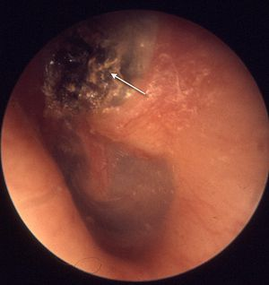
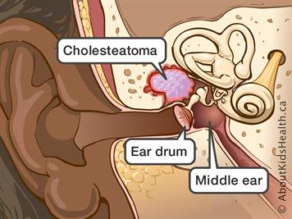
Inflammatory lesions and disorders of ear
Predisposing factor:
Recurrent common cold, URTI, exanthematous fevers (like measles, diphtheria, whooping cough)
Infection of tonsils and adenoids
Chronic rhinitis and sinusitis
Nasal allergy
Tumors of nasopharynx
Cleft palate
Causative agents:
Staphylococcus aureus
Pseuomonas aeruginosa
Streptococci
Klebsiella
Proteus
Figs: Cholesteatoma
Notes:
Exanthematous: rash. Adenoids: are an overgrowth of glandular tissue at the back of the throat, into which the nose opens.

Slide 11
Inflammatory lesions and disorders of ear
Route of infection:
Eustachian tube
Infection from nose, nasopharynx and oropharynx (URTI)
Infected mucus after nose blowing
Occasionally regurgitated milk or vomits in infants can reach the middle ear cavity through ET
Perforated tympanic membrane
Infection can reach the middle ear cavity through an existing perforation in TM when water enters the ear cavity while bathing, putting oil or cleaning the ear with cotton buds or matchsticks.
Blood borne
Influenza and exanthematous fever

Slide 12
Inflammatory lesions and disorders of ear
Clinical features:
Recurrent ear discharge
Hearing loss due to impair mobility of TM and ossicular chain
Perforated TM
Edematous or congested middle ear mucosa
Ossicles – intact/discontinuity
Pain with fever
Investigation:
Audiogram
X-ray of mastoids
Pus culture and sensitivity
Notes:
Audiogram A graph produced during hearing tests (with an audiometer) that shows the hearing threshold –the minimal audible loudness level – for a range of sound frequencies.

Slide 13
Eye

Slide 14
Eye
The eye is the organ of the sense of sight situated in the orbital cavity and it is supplied by the optic nerve (2nd cranial nerve).
It is almost spherical in shape and is about 2.5 cm in diameter.
The space between the eye and the orbital cavity is occupied by adipose tissue.
The bony walls of the orbit and the fat help to protect the eye from injury.
Structure:
There are three layers of tissue in the walls of the eye.
They are:
• the outer fibrous layer: sclera and cornea
• the middle vascular layer or uveal tract: choroid, ciliary body and iris
• the inner nervous tissue layer: retina.
Structures inside the eyeball are the lens, aqueous fluid and vitreous body.

Slide 15
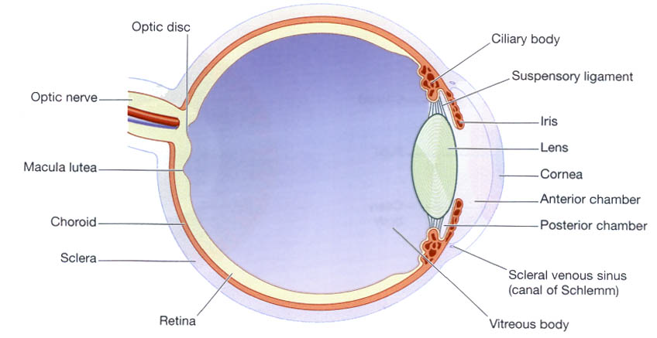
Eye
Fig: Section of the eye

Slide 16
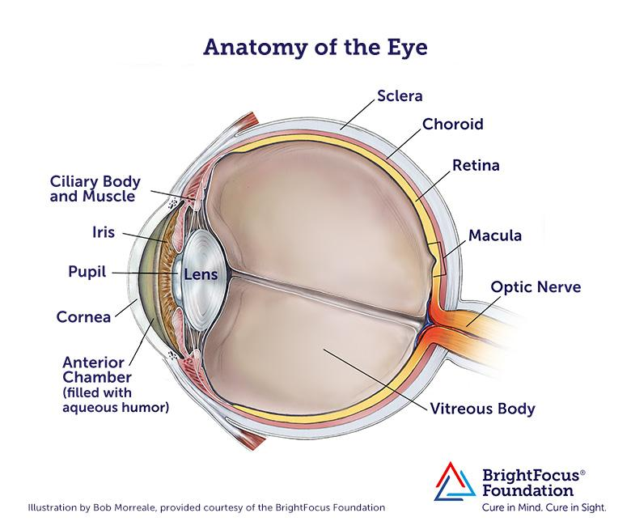
Eye

Slide 17
Inflammatory conditions of eye
Inflammatory conditions of the eye are designated according to the tissue affected.
‘Uveitis’ is the commonly used term for the ocular inflammation of the uveal tract which is the most vascular tissue of the eye.
However, specific designation is used for the type of tissue of eye inflamed.
Stye (hordeolum):
This is an acute and painful bacterial infection of sebaceous or tarsal glands (Meibomian glands) of the eyelid margin.
This presents as a painful small red lump at the lid margin. It is an acute suppurative inflammation of sebaceous gland.
Infection of tarsal glands may block their ducts, leading to cyst formation (chalazion) which may damage the cornea.
The most common infecting organism is Staphylococcus aureus.

Slide 18
Inflammatory conditions of eye
Endophthalmitis:
It is an acute suppurative intraocular inflammation which may be of exogenous or endogenous origin.
The exogenous agents may be bacteria, viruses or fungi introduced into the eye during an accidental or surgical perforating wound.
The endogenous agents include opportunistic infections which may cause endophthalmitis via haematogenous route e.g. candidiasis, toxoplasmosis, nocardiosis, aspergillosis and cryptococcosis.

Slide 19
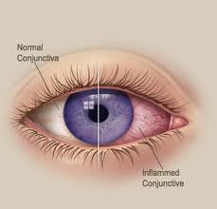
Inflammatory conditions of eye
Conjunctivitis:
Inflammation of the conjunctiva may be caused by irritants, such as smoke, dust, wind, cold or dry air, microbes or antigens. Corneal ulceration is a rare complication.
Microbial infection:
In adults this is usually caused by strains of Staphylococci, Streptococci, Pneumococci and Haemophilus.

Slide 20
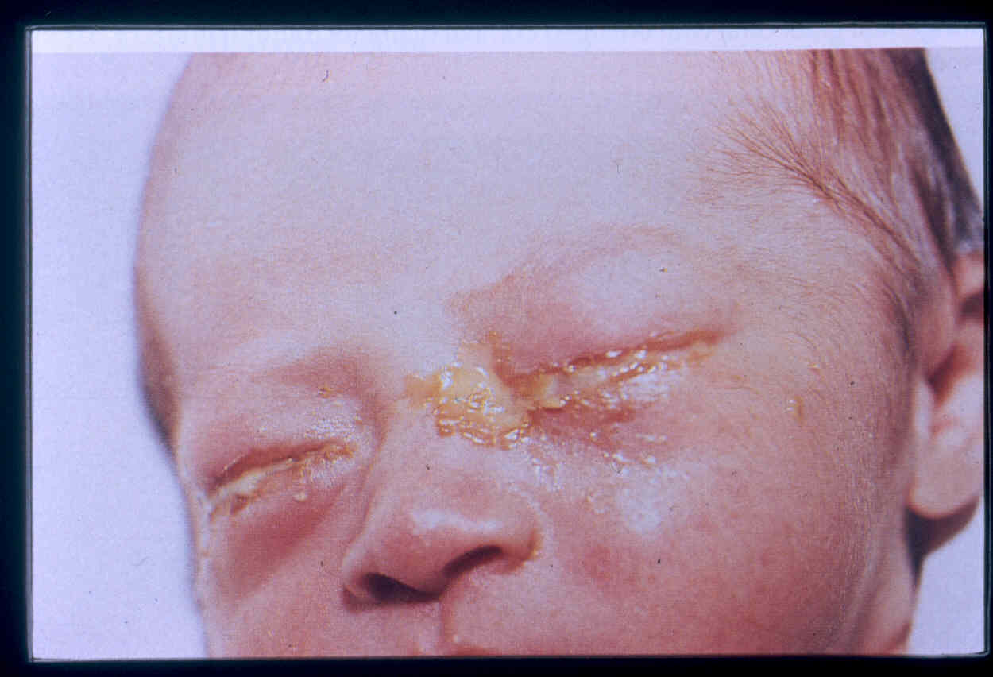
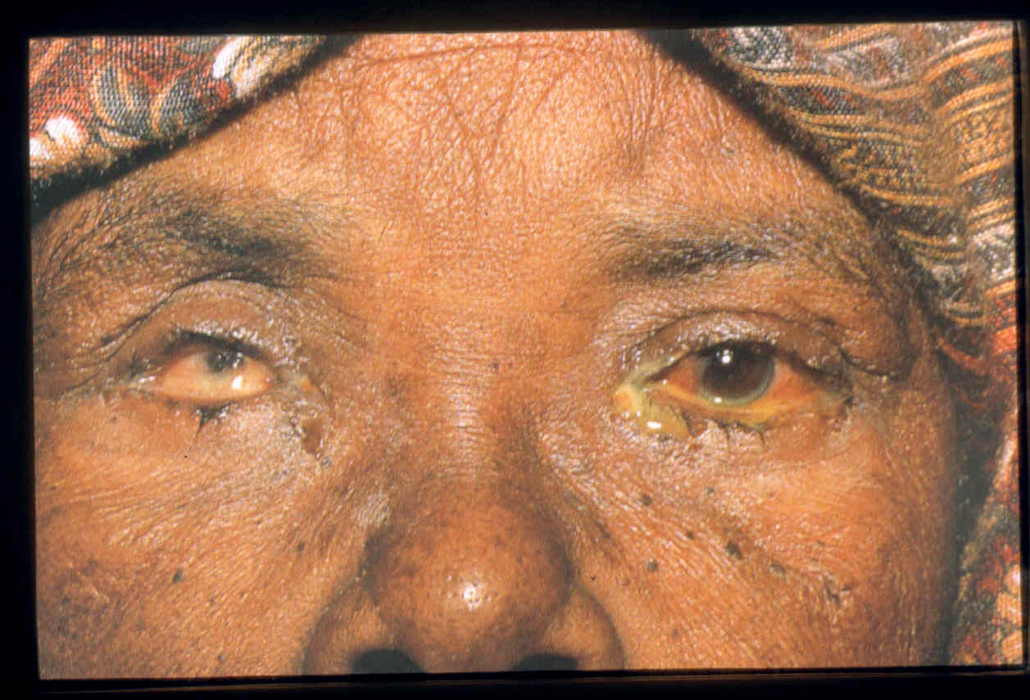
Inflammatory conditions of eye
Conjunctivitis:
Neonatal conjunctivitis:
This occurs within 28 days of birth and is commonly caused by Neisseria gonorrhoea, Chlamydia trachomatis or Herpes Simplex Virus. It is usually acquired when microbes contaminate the baby's eyes during delivery. Infection may cause corneal ulceration.
Allergic conjunctivitis:
This may be a complication of hay fever i.e. allergic rhinitis or be caused by a wide variety of airborne antigens, e.g. dust, pollen, fungus spores, animal dander, cosmetics, hair sprays, soaps. The condition sometimes becomes chronic.
Opthalmia neonatorum

Slide 21
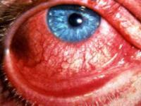
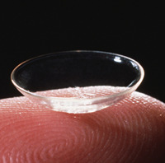
Inflammatory conditions of eye
Keratitis:
Inflammation of the cornea in response to a variety of insults – viral, bacterial, chemical, radiation, or mechanical trauma.
Keratitis may be superficial or involve the deeper layers, the latter being generally more serious.
The eye is usually red, painful and photophobic.
Risk factors: Contact lens, trauma.
Causative agents:
Bacteria: Pseudomonas aeruginosa,
S. aureus, Streptococcus.
Virus: Herpes simplex virus.
Fungi: Aspergillus, Fusarium
Parasite : Acanthamoeba species.

Slide 22
Inflammatory conditions of eye
Cataract:
A term used to describe any opacity in the lens of the eye, from the smallest spot to total opaqueness.
In age-related cataract there is gradual development of lens opacity that usually develops during older age as the result of exposure to a variety of predisposing factors including: UV light, X-rays, cigarette smoke, diabetes mellitus, ocular trauma, uveitis, systemic drug therapy, e.g. corticosteroids.
Congenital cataract may be due to genetic abnormality, e.g. Down's syndrome, or maternal infection in early pregnancy, e.g. rubella.
Early treatment is required to prevent permanent blindness.
The lens is mostly made from water and protein – it’s thought cataracts develop because of changes in the proteins, that result in cloudy vision.

Slide 23
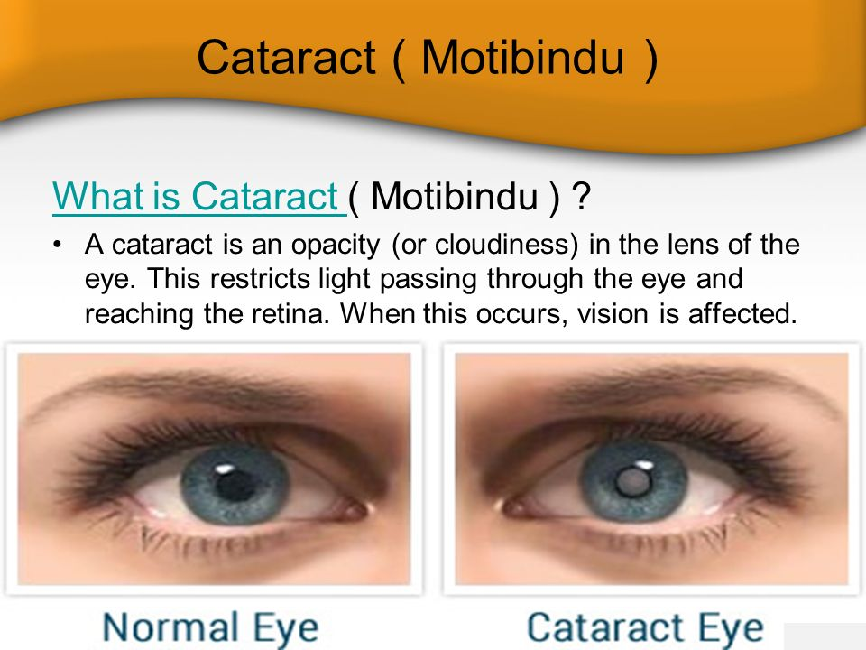

Inflammatory conditions of eye
Cataract:
The various causes of cataract are: senility, congenital (e.g. Down syndrome, rubella, galactosaemia), traumatic (e.g. penetrating injury, electrical injury), metabolic (e.g. diabetes, hypoparathyroidism), and associated with drugs (e.g. longterm corticosteroid therapy), smoking and heavy alcohol consumption.
Histologically, the lens fibres undergo degeneration, fragmentation and liquefaction but the central nucleus remains intact because it is quite sclerotic.

Slide 24
Inflammatory conditions of eye
Glaucoma:
Glaucoma is a group of ocular disorders that have in common increased intraocular pressure.
Glaucoma is one of the leading causes of blindness because of the ocular tissue damage produced by raised intraocular pressure.
In almost all cases, glaucoma occurs due to impaired outflow of aqueous humour, though there is a theoretical possibility of increased production of aqueous by the ciliary body causing glaucoma.
Aqueous humour is constantly being produced by cells of the ciliary body and constantly drained away through the trabecular meshwork. The trabecular meshwork lies in the angle between the iris and inner surface of the cornea.

Slide 25
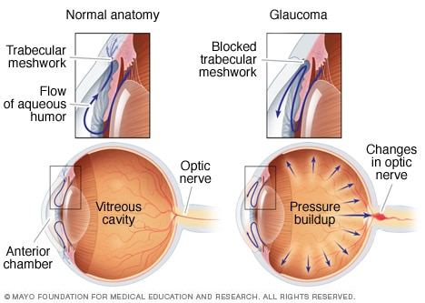
Inflammatory conditions of eye
Glaucoma:
Damages optic nerve

Slide 26
Skin

Slide 27
Skin
The skin completely covers the body and is continuous with the membranes lining the body orifices.
Functions:
protects the underlying structures from injury and from invasion by microbes
contains sensory (somatic) nerve endings of pain, temperature and touch
is involved in the regulation of body temperature.
Structure of skin:
The skin has a surface area of about 1.5 to 2 m² in adults and it contains glands, hair and nails.
There are two main layers:
• epidermis
• dermis.
Between the skin and underlying structures there is a layer of subcutaneous fat.

Slide 28
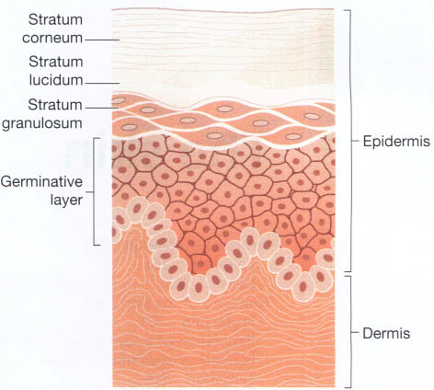
Skin
Fig: The skin showing the main layers of the epidermis.

Slide 29
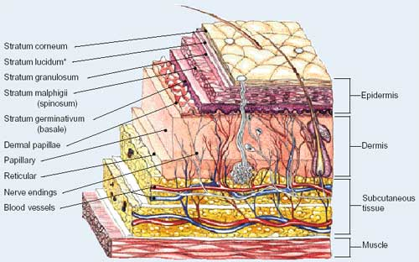
Skin
Fig: Cross-section of the skin.

Slide 30
Skin
Disorder of skin

Slide 31
Disorder of skin
Dermatitis (eczema):
It refer to inflammatory response to a variety of agents acting on the skin from outside or from within the body such as chemicals and drugs, hypersensitivity to various antigens and haptens etc.
Atopic dermatitis is caused by allergens and commonly affects atopic individuals. Children who may also suffer from hay fever or asthma are often affected.
Contact dermatitis may be caused by:
direct contact with irritants, e.g. cosmetics, soap, detergent, strong acids or alkalis, industrial chemicals
a hypersensitivity reaction to, e.g., synthetic rubber, nickel, dyes and other chemicals.
In general, these conditions are clinically characterised by itching, erythema with edema, oozing and scaling.
Notes:
Oozing: discharge

Slide 32
Disorder of skin
Dermatitis (eczema):
In the case of contact dermatitis, the pattern of skin involvement is limited to sites of contact with the triggering agent, whereas in other forms of eczema, lesions may be widely distributed.
Epidermal edema also called Spongiosis characterizes all forms of acute eczematous dermatitis (spongiotic dermatitis).
Edema fluid seeps into the epidermis, where it splays apart keratinocytes. Intercellular bridges are stretched and become more prominent and are easier to visualize.
This change is accompanied by a superficial perivascular lymphocytic infiltrate, edema of dermal papillae, and mast cell degranulation.
Eosinophils may be present.
Notes:
Splay: spread

Slide 33
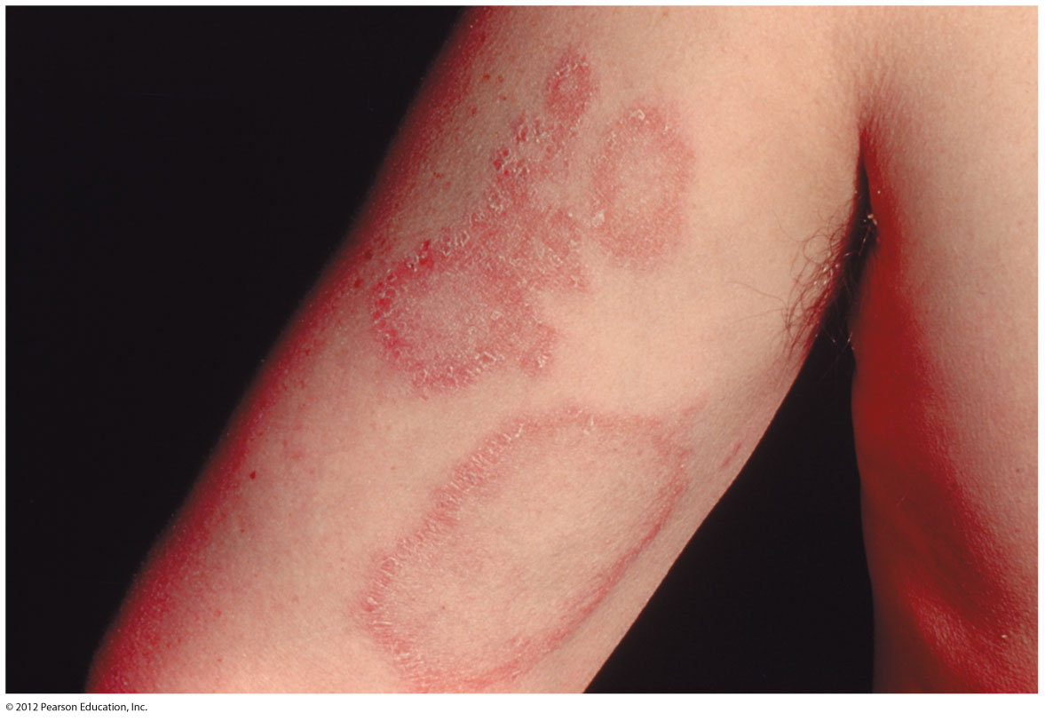
Disorder of skin
Urticaria
The rash produced by the sudden release of histamine in the skin.
It is characterised by acute itching, redness and wealing which subsides within a few minutes or may persist for a day or more.
Depending upon the cause, it may be localised or widespread and transient or constantly recurrent over years. It has many causes.
Fig: Urticaria (allergy in skin)
Notes:
Wealing: a raised mark on the skin; circular pattern

Slide 34
Disorder of skin
Miliaria
a condition in which there is cutaneous retention of sweat due to obstruction of sweat ducts.
There are 2 types of miliaria: miliaria crystallina and miliaria rubra.
Miliaria crystallina occurs when there is obstruction of sweat duct within the stratum corneum. It occurs in areas of the skin exposed to sun or may occur during a febrile illness.
Miliaria rubra occurs when there is obstruction of sweat ducts within the deeper layers of the epidermis. It is seen more often in areas of skin covered by clothes following profuse sweating and the lesions are itchy.
Notes:
Fibrile ill: fever, rash, joint pain, redness

Slide 35
Disorder of skin
Panniculitis
It is inflammation of the subcutaneous fat. It may be acute or chronic.
Generally, panniculitis appears as nodular lesions, predominantly on the lower legs.
The following types of panniculitis are described:
Erythema nodosum, acute or chronic, is the most common form. The lesions consist of tender red nodules, 1-5 cm in diameter, seen more often on the anterior surface of the lower legs. It is often found in association with bacterial or fungal infections, drug intake, inflammatory bowel disease and certain malignancies.
Erythema induratum is a less common variety. The lesions are chronic, painless, slightly tender, recurrent and found on the calves of lower legs.

Slide 36
Disorder of skin
Acne vulgaris
A common inflammatory disorder of the sebaceoous glands which are under androgen control, but the cause of acne is unknown.
Found predominantly in adolescents in both sexes.
The lesions are seen more commonly on the face, upper chest and upper back. The appearance of lesions around puberty is related to physiologic hormonal variations.
The condition affects the hair follicle, the opening of which is blocked by keratin material resulting in formation of comedones.
Histologically, a comedone consists of keratinised cells, sebum and bacteria.
Comedones may be open having central black appearance due to oxidation of melanin called black heads, or they may be in closed follicles referred to as white heads.

Slide 37
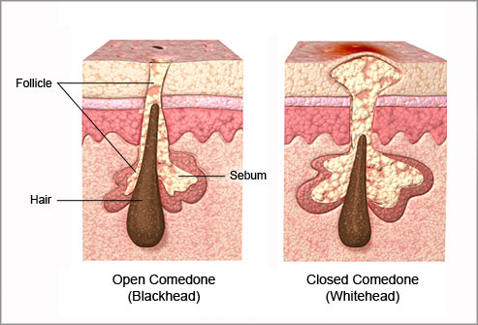
Disorder of skin
Acne vulgaris

Slide 38
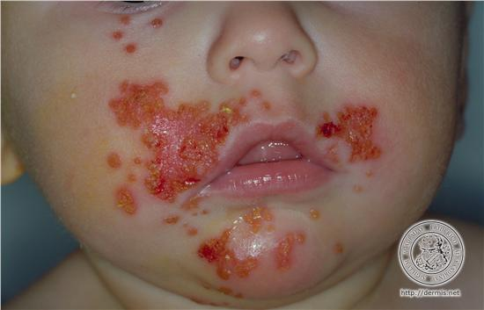
Disorder of skin
Infectious dermatoses:
Microorganisms such as bacteria, viruses and fungi are responsible for a large number of dermatoses.
Impetigo
Impetigo is a common superficial bacterial infection caused by Staphylococci and Streptococci.
The condition may occur in children or in adults and more commonly involves hands and face.
The lesions appear as vesico-pustules which may rupture and are followed by characteristic yellowish crusts.

Slide 39
Disorder of skin
Verrucae (warts)
Verrucae or warts are common viral lesions of the skin.
They are caused by human papillomaviruses (HPV) that belong to papovavirus group, a type of DNA oncogenic virus.
They are common lesions of children and adolescents, although they may be encountered in any age group.
Transmission usually involves direct contact with an infected individual or autoinoculation. They generally are self-limited, most often regressing spontaneously within 6 months to 2 years.
The virus subverts cell cycle control to allow increased proliferation of epithelial cells and production of new virus. The immune response normally limits the growth of these tumors, and immunodeficiency often is associated with increased numbers and larger sized verrucae or warts.
Notes:
Subverts: weaken

Slide 40
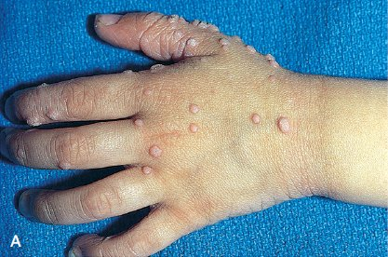
Disorder of skin
Fig: Multiple warts, with characteristic rough, pebble-like surfaces.

Slide 41
Disorder of skin
Viral exanthemata
Viral exanthemata are a group of contagious conditions in which the epidermal cells are destroyed by replicating viruses causing eruption or rash.
There are predominantly two groups of viruses which may cause exanthem.
These are: the poxvirus group (e.g. smallpox or variola, cowpox or vaccinia), and the herpesvirus group (e.g. chickenpox or varicella, herpes zoster or shingles, herpes simplex).
Clinically, these conditions have different presentations but the eruptive lesions may look alike and are, therefore, considered together.

Slide 42
Disorder of skin
Superficial mycoses
Superficial fungal infections of the skin are localised to stratum corneum.
These include some of the common dermatophytes such as:
Trichophyton rubrum, T. interdigitale, Epidermophyton floccosum and Pityrosporum.
Clinically, these fungal infections are labelled according to the region involved. These are as follows:
Tinea capitis occurring on the scalp, especially in children.
Tinea barbae affecting the region of beard in adult males.
Tinea corporis involving the body surface at all ages.
Tinea cruris occurs most frequently in the region of groin in obese men, especially in hot weather.
Tinea pedis or ‘athlete foot’ is located in the web spaces between the toes.
Onychomycosis shows disintegration of the nail substance.
Tinea versicolor caused by Malassezia furfur generally affects the upper trunk.

Slide 43
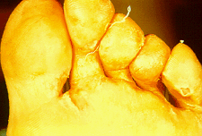
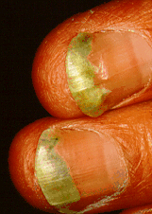
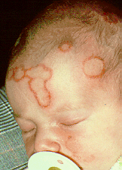
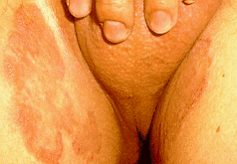
Tinea pedis
Onychomycosis
Tinea cruris
Tinea capitis

Slide 44
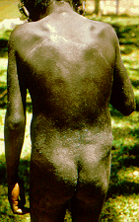
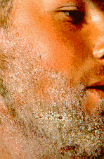
Tinea corporis
Tinea barbae

Slide 45
Disorder of skin
Granulomatous diseases
Containing epithelioid cell granulomas having giant cells and lymphocytes.
Lupus vulgaris (cutaneous tuberculosis): The lesions found most commonly on the head and neck, especially skin of the nose. They are yellowish-brown to reddish-brown tiny nodules (apple-jelly nodules).
Cutaneous sarcoidosis: The lesions appear in the skin, lungs, eyes, nose and lymph nodes. It include erythema nodosum, or brown-red jelly-like papules or plaques.
Granuloma annulare: Dermal nodules are arranged in a ring-like fashion, commonly on the hands and feet. The condition appears to have correlation with diabetes mellitus. The exact cause is unknown (idiopathic). Numerous theories exist linking the cause to trauma, sun exposure, thyroid disease, tuberculosis, and various viral infections
Notes:
Sarcoidosis: An uncommon chronic inflammatory disease of unknown origin which can affect many organs, particularly the SKIN, eyes and LUNGS.

Slide 46
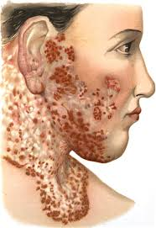
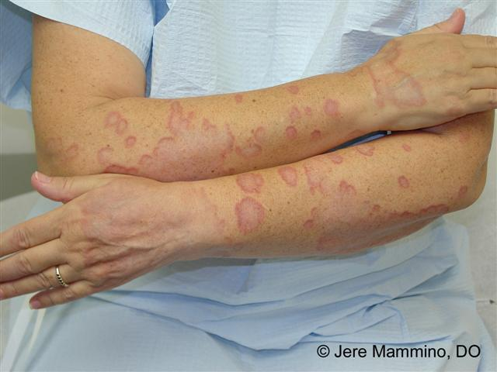
Disorder of skin
Lupus vulgaris
Granuloma annulare

Slide 47
Disorder of skin
Chronic inflammatory dermatoses
The skin surface in roughened due to excessive and abnormal scale formation and desquamation (shedding).
Psoriasis:
Lesions are characterised by brownish-red papules and plaques which are sharply demarcated and are covered with fine, silvery white scales.
As the scales are removed by gentle scrapping, fine bleeding points appear termed Auspitz sign. Commonly involved sites are the scalp, upper back, sacral region and the knees and elbows.
Chronic autoimmune condition
It sometimes occurs in association with arthritis (psoriatic arthritis).
Lichen planus:
Characterised clinically by irregular, shining, flat-topped, pruritic or itching papules. The lesions are distributed on the surface of the wrists, forearms, legs and external genitalia. Buccal mucosa is also involved.
Notes:
Demarcated: differentiated. Pruritic: itching

Slide 48
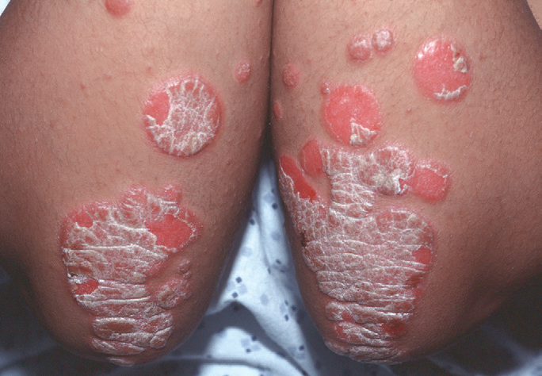
Disorder of skin
Fig: Chronic plaques of psoriasis show silvery-white scale on the surface of erythematous plaques.

Slide 49
Eye tumors

Slide 50
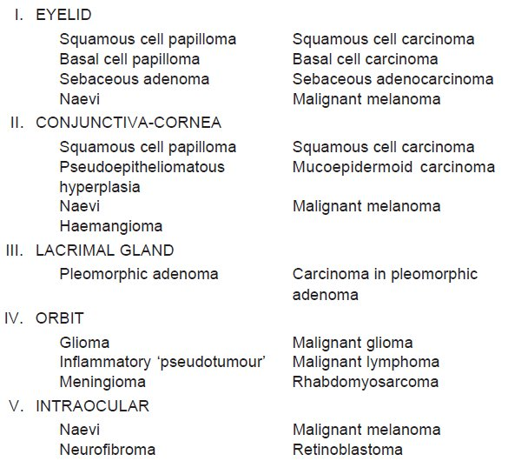
Classification of eye tumors
Benign Malignant
Notes:
Naevus: A congenitally determined tissue abnormality or skin mark

Slide 51
Retinoblastoma

Slide 52
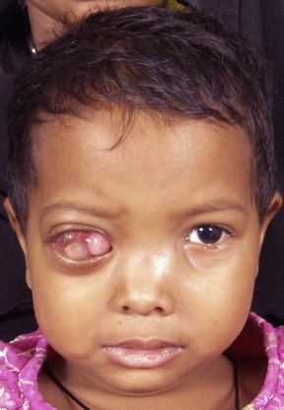
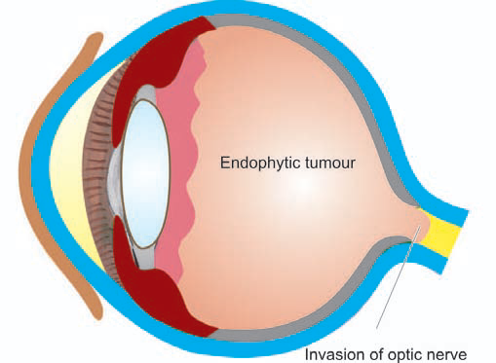
Retinoblastoma:
It is highly malignant tumour of the retina that generally affects children.
Tumor of infancy and childhood
It is believed to arise from a cell of neuroepithelial origin in the retina.
Fatal once it spread outside the eye and orbit and spread backward along the optic nerve to invade brain.

Slide 53
Retinoblastoma:
Causes:
It is caused by the so-called retinoblastoma gene (RB gene) which is mutation in the long arm of chromosome 13.
Other predisposing factors:
Positive family history
Exposure to radiation
Congenital due to opthalmotoxic drugs
Types:
Hereditary or familial cases: affects both copy of RB gene; tumors affecting both eyes.
Non-hereditary or sporadic cases: affects one copy of RB gene; tumor in one eye

Slide 54
Retinoblastoma:
Sign and symptoms:
White glow in the eye often seen in photographic flash
White spots in pupil
A red painful eye
Decreased vision
Hyphema (collection of blood in each eye)
Eyeball became bigger
Nystagmus
Exopthalmia
Secondary glaucoma

Slide 55
Retinoblastoma:
Treatment/Management:
Chemotherapy
Radiotherapy
Enucleation
If untreated, the tumors are fatal, but after early treatment, survival is the rule.

Slide 56
Skin Tumors

Slide 57
Skin Tumors
The skin is the largest organ of the body.
Tumours and tumour-like lesions may arise from different components of the skin such as surface epidermis, epidermal appendages and dermal tissues.
Each of these tissues may give rise to benign and malignant tumours as well as tumour-like lesions.

Slide 58
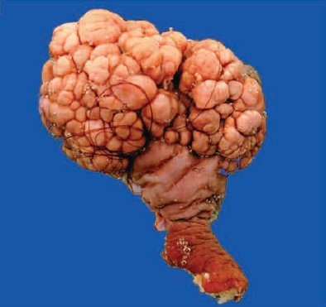
Skin Tumors
Squamous Papilloma
Squamous papilloma is a benign epithelial tumour of the skin.
May include common viral warts (verrucae) and condyloma accuminata (rounded swelling of mucous membrane).
Histologically, squamous papillomas are characterised by hyperkeratosis, acanthosis (darkly pigmented) with elongation of rete ridges and papillomatosis.
Fig: Squamous cell papilloma. The skin surface shows a papillary growth with a pedicle.
Notes:
Condyloma: A localised, rounded swelling of mucous membrane around the opening of the bowel, and the genital organs, sometimes known as ‘genital warts’. Acanthosis: darkly pigmented

Slide 59
Skin Tumors
Epidermal Cyst
These intradermal or subcutaneous cysts, commonly called sebaceous cysts, are common and may occur spontaneously or due to implantation of the epidermis into the dermis or subcutis (implantation cysts).
Most frequent sites are the skin of face, scalp, neck and trunk.
Histologically, epidermal cysts have a cyst wall composed of true epidermis with laminated layers of keratin.
Rupture of the cyst may incite foreign body giant cell inflammatory reaction in the wall.
Dermoid Cyst
These are subcutaneous cysts often present since birth. Dermoid cysts are more common on the face.

Slide 60
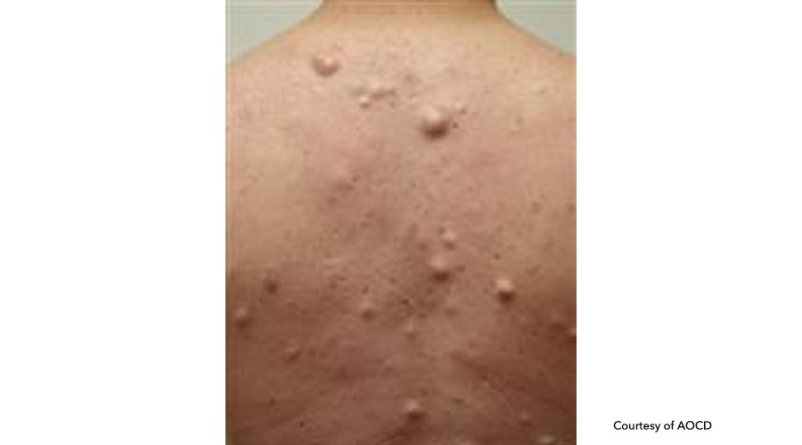
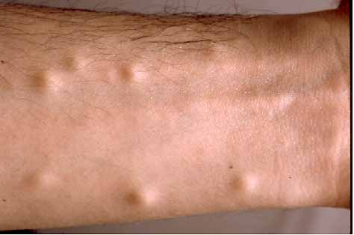
Skin Tumors
Steatocystoma Multiplex
This is an inherited autosomal dominant disorder having multiple cystic nodules, 1-3 cm in size. They are more common in the axillae, sternum and arms.
Histologically, the cyst walls are composed of several layers of epithelial cells and contain lobules of sebaceous glands in the cyst wall.
Steatocystoma Multiplex
Epidermal Cyst

Slide 61
Skin Tumors
Solar Keratosis (Actinic Keratosis, Senile Keratosis)
Solar (sun-induced) or actinic (induced by a variety of rays) keratoses are the multiple lesions occurring in sun-exposed areas of the skin in fair-skinned elderly people.
Similar lesions may be induced by exposure to ionising radiation, hydrocarbons and arsenicals.
The condition is considered to be a precursor of invasive squamous cell and/or basal cell carcinoma.
Clinically, the lesions are tan-brown, erythematous, about 1 cm in diameter with rough, sandpaper-like surface and are seen more commonly on the dorsum of the hands and on the balded portion of the skin.

Slide 62
Skin Tumors
Histologically, solar keratoses are squamous cell carcinoma has following characteristic features:
Considerable hyperkeratosis (Hyperplasia of the stratum corneum, often associated with a qualitative abnormality of Keratin)
Marked acanthosis (Diffuse epidermal hyperplasia)
Dyskeratosis and dysplasia of the epidermal cells (Abnormal keratinization or developments of cells)
Non-specific chronic inflammatory cell infiltrate

Slide 63
Skin Tumors
Bowen’s Disease
Bowen’s disease is also a carcinoma of the entire epidermis but differs from solar keratosis in having solitary lesion often that may occur on sun-exposed as well as sun-unexposed skin.
Xeroderma Pigmentosum
This condition is a hypersensitivity of the skin to sunlight that is determined by a recessive gene.
The disorder may lead to multiple malignancies of the skin such as basal cell carcinoma, squamous cell carcinoma and malignant melanoma.

Slide 64
Skin Tumors
Squamous Cell Carcinoma
Squamous cell carcinoma may arise on any part of the skin and mucous membranes lined by squamous epithelium but is more likely to occur on sun-exposed parts in older people.
Various predisposing conditions include the following:
Xeroderma pigmentosum
Solar keratosis
Chronic inflammatory conditions such as chronic ulcers and draining osteomyelitis
Old burn scars
Chemical burns
Psoriasis
HIV infection
Ionising radiation
Industrial carcinogens (Coal tars, oils, etc.)
In the case of cancer of oral cavity, chewing betel nuts and tobacco.

Slide 65
Skin Tumors
Common locations
Although squamous carcinomas can occur anywhere on the skin, most common locations are the face, pinna of the ears, back of hands and mucocutaneous junctions such as on the lips, anal canal and glans penis.
Clinical features
Appears as defined, red, scaling plaques; many arising from prior solar/actinic keratoses. More advanced, invasive lesions are nodular, show variable scale, and may ulcerate.
Pathogenesis
The most common exogenous cause of cutaneous squamous cell carcinoma is UV light exposure, which causes DNA damage. Individuals who are immunosuppressed as a result of chemotherapy or organ transplantation, or who have xeroderma pigmentosum, are at increased risk. Immunosuppressed patients are high risk with HPV types.

Slide 66
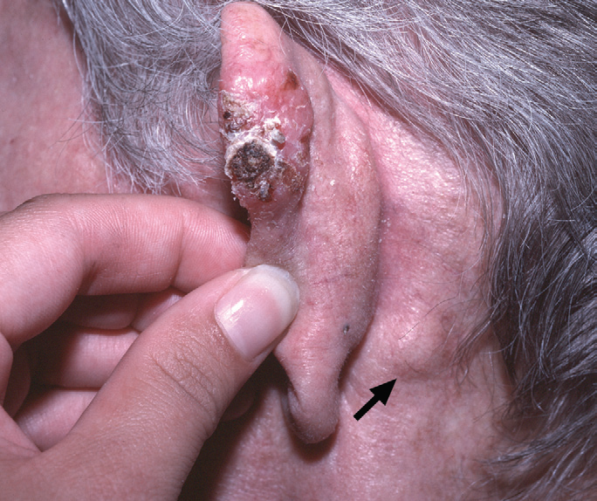
Skin Tumors
Fig: Invasive squamous cell carcinoma. A nodular, hyperkeratotic lesion occurring on the ear, associated with metastasis to a prominent postauricular lymph node (arrow).

Slide 67
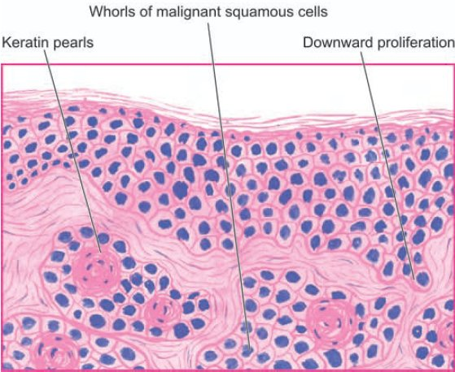
Skin Tumors
Fig: Microscopic features of well-differentiated squamous cell carcinoma. The dermis is invaded by downward proliferating epidermal masses of cells which show atypical features. A few horn pearls with central laminated keratin are present. There is inflammatory reaction in the dermis between the masses of tumour cells.

Slide 68
Skin Tumors
Basal Cell Carcinoma (Rodent Ulcer)
Typically, the basal cell carcinoma is a locally invasive, slow growing tumour of middle-aged that rarely metastasises.
It occurs exclusively on hairy skin, the most common location (90%) being the face, usually above a line from the lobe of the ear to the corner of the mouth.
Basal cell carcinoma is seen more frequently in white-skinned people and in those who have prolonged exposure to strong sunlight like in those living in Australia and New Zealand.
As with squamous cell carcinoma, the incidence of basal cell carcinoma increases with immunosupression and in individuals with inherited defect in DNA repair.

Slide 69
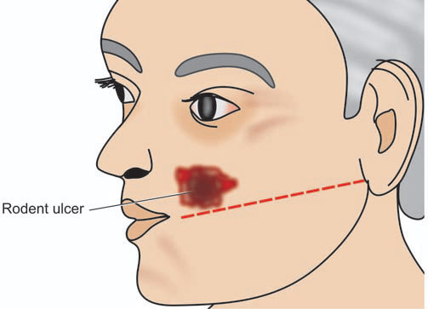
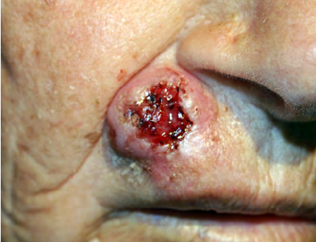
Skin Tumors
Fig: Common location and macroscopic appearance of basal cell carcinoma (rodent ulcer).

Slide 70
Skin Tumors
Morphologic Features
Grossly, the most common pattern is a nodulo-ulcerative basal cell carcinoma in which a slow-growing small nodule undergoes central ulceration with rolled margins.
The tumour enlarges in size by burrowing and by destroying the tissues locally like a rodent and hence the name ‘rodent ulcer’.
Histologically, the most characteristic feature is the proliferation of basaloid cells (resembling basal layer of epidermis), with characteristic peripheral palisaded appearance.

Slide 71
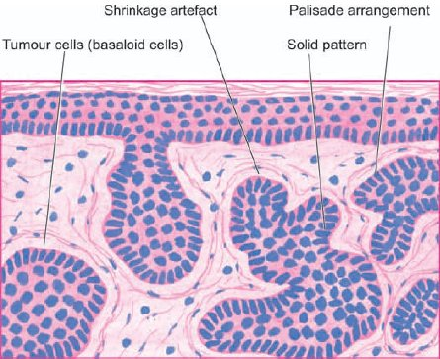
Skin Tumors
Fig: Basal cell carcinoma. The dermis is invaded by irregular masses of basaloid cells with characteristic peripheral palisaded appearance. The masses of tumour cells are separated from dermal collagen by a space called shrinkage artifact.

Slide 72
Skin Tumors
Malignant Melanoma
Malignant melanoma or melanocarcinoma arising from melanocytes is one of the most rapidly spreading malignant tumour of the skin that can occur at all ages but is rare before puberty.
The tumour spreads locally as well as to distant sites by lymphatics and by blood.
The etiology is unknown but there is role of excessive exposure of white skin to sunlight e.g. higher incidence in New Zealand and Australia where sun exposure in high.
Besides the skin, melanomas may occur at various other sites such as oral and anogenital mucosa, oesophagus, conjunctiva, orbit and leptomeninges.
The common sites on the skin are the trunk (in men), legs (in women); other locations are face, soles, palms and nail-beds.

Slide 73
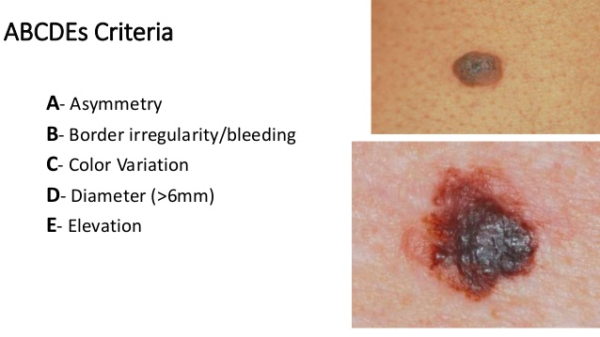
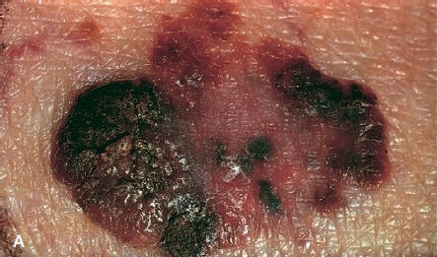
Skin Tumors
Clinical features:
Asymmetry
Border irregularity
Colour change
Diameter >6 mm
Elevation
Common locations:
Skin,
Mucosa of nose, bowel, anal region
Cell morphology:
Malignant cells, atypical, mitoses, nucleoli
Melanin pigment:
Fine granules, uniformly distributed
Inflammation:
Often present
Spread:
Haematogenous / lymphatic spread

Slide 75
Xerophthalmia
Refers to the ocular manifestation of vitamin A deficiency
Most wide spread and serious nutritional disorders leading to blindness particularly in south-east Asia
Most common in younger children
Associated risk factor includes ignorance, faulty feeding practice and infection particularly diarrhoea, measles, etc.
The term Xerophthalmia (dry eye) comprises all ocular manifestation of vitamin deficiency ranging from night blindness to keratomalacia.

Slide 76
Xerophthalmia
WHO classification:
XN: Night Blindness (earliest symptoms)
X1: Conjunctival Xerosis (X1A) with Bitot’s spot (X1B)
Conjunctival Xerosis (X1A): first sign of vitamin A deficiency. Conjunctiva becomes dry and non-wettable.
Bitot’s spot (X1B): these are triangular, pearly white or yellowish, foamy spots on the bulbar conjunctiva on either side of cornea.
X2: Corneal ulceration. This stage is particularly serious. The cornea is dull, dry, non-wettable and eventually opaque.
X3: Corneal ulceration less than one-third (X3A). Affecting more than one-third corneal surface: (X3B). In more severe deficiency there may be corneal ulceration. The ulcer may heal leaving a corneal scar which can affect vision.
XS: Corneal scar (healing defect of ulcer)
XF: Xeropthalmic fundus (whitish lesion of fundus)

Slide 77
The End…!!!!!!
Thank You…!!!

